Slide 1
HNDIT 2312-Principles of Software Engineering
Week 7: Software Architecture

Slide 2
Topics Covered
Architectural design decisions
Architectural views
Architectural patterns

Slide 3
Software architecture
The design process for identifying the sub-systems making up a system and the framework for sub-system control and communication is architectural design.
The output of this design process is a description of the software architecture.

Slide 4
Architectural design
An early stage of the system design process.
Represents the link between specification and design processes.
It involves identifying major system components and their communications.

Slide 5
Advantages of Software architecture
Stakeholder communication
Architecture may be used as a focus of discussion by system stakeholders.
System analysis
Means that analysis of whether the system can meet its non-functional requirements is possible.
Large-scale reuse
The architecture may be reusable across a range of systems
Product-line architectures may be developed.

Slide 6
Architectural representations
Simple, informal block diagrams showing entities and relationships are the most frequently used method for documenting software architectures.

Slide 7
Architectural patterns
Patterns are a means of representing, sharing and reusing knowledge.
An architectural pattern is a stylized description of good design practice, which has been tried and tested in different environments.

Slide 8
Common architectural patterns
Layered pattern
Client-server pattern
Model-view-controller pattern
Master-slave pattern
Pipe-filter pattern
Broker pattern
Peer-to-peer pattern
Event-bus pattern

Slide 9
Layered architecture
Used to model the interfacing of sub-systems.
Organises the system into a set of layers (or abstract machines) each of which provide a set of services.
Supports the incremental development of sub-systems in different layers. When a layer interface changes, only the adjacent layer is affected.

Slide 10
Layered architecture
Common four layers
Presentation layer (also known as UI layer)
Application layer (also known as service layer)
Business logic layer (also known as domain layer)
Data access layer (also known as persistence layer)
Usage
General desktop applications.
E commerce web applications.

Slide 11
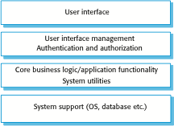
Layered architecture

Slide 12
Client-server architecture
Distributed system model which shows how data and processing is distributed across a range of components.
Can be implemented on a single computer.
Set of stand-alone servers which provide specific services such as printing, data management, etc.
Set of clients which call on these services.
Network which allows clients to access servers.

Slide 13
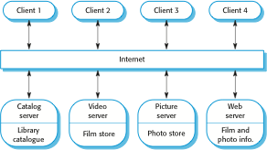
A client–server architecture for a film library

Slide 14
Client-server architecture
This pattern consists of two parties; a server and multiple clients. The server component will provide services to multiple client components.
Usage
Online applications such as email, document sharing and banking.

Slide 15
Model-view-controller pattern
This pattern, also known as MVC pattern, divides an interactive application in to 3 parts
model — contains the core functionality and data
view — displays the information to the user (more than one view may be defined)
controller — handles the input from the user
Usage
Web based application

Slide 16
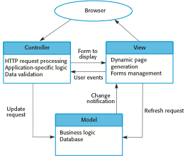
Web application architecture using the MVC pattern

Slide 17
Pipe and filter architecture
Functional transformations process their inputs to produce outputs.
May be referred to as a pipe and filter model (as in UNIX shell).
Usage
Compilers. The consecutive filters perform lexical analysis, parsing, semantic analysis, and code generation.

Slide 18
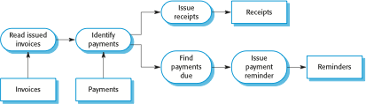
Pipe and filter architecture

Slide 19
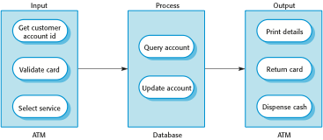
The software architecture of an ATM system

Slide 20
Key points
A software architecture is a description of how a software system is organized.
An architectural pattern is a general, reusable solution to a commonly occurring problem in software architecture within a given context.
Architectural patterns are a means of reusing knowledge about generic system architectures.

